Slide 1
NN + oscillations
Mo, 30/05/22

Slide 2
Suggestions 8/04/22
Convolution over quadrants instead of copying weight matrix
Binary cross-entropy loss instead of cross-entropy/quadratic loss, such that every node indicates the probability that the input is one of the respective letters
Learn bias instead of shifting sigmoid by hand
Learn hyperparameters of the dynamics instead of tuning by hand (need electrophysio data for that?)
Replicate results of "AET" problem using API (e.g. Keras/Pytorch)

Slide 3
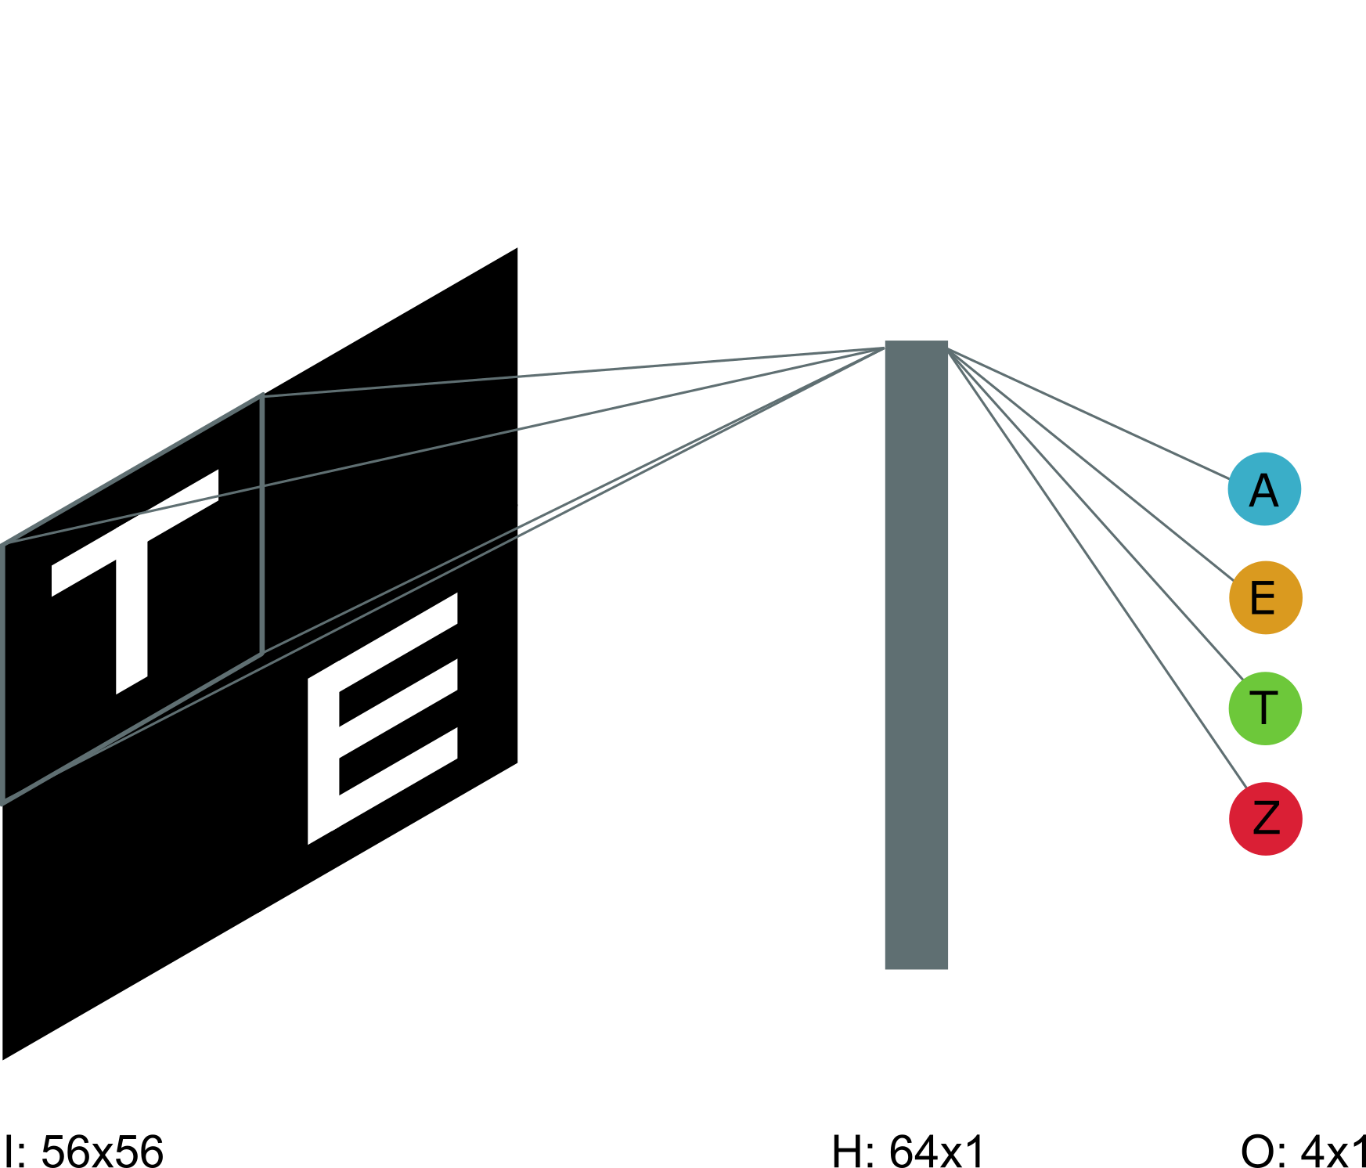
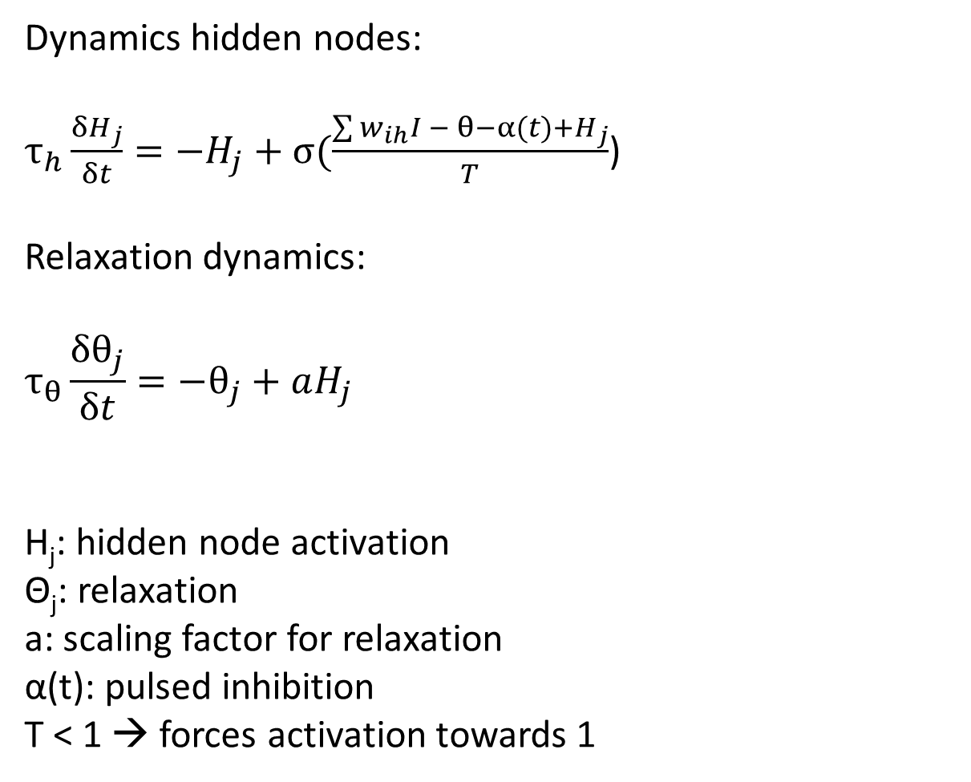
Model & dynamics
Dynamics hidden nodes:
$τ_{h}\frac{{δH}_{j}}{δt}=−H_{j}+σ(\frac{\sum{w_{ih}I − θ−α(t)+}H_{j}}{T}$)
Relaxation dynamics:
$$τ_{θ}\frac{δθ_{j}}{δt}=−θ_{j}+aH_{j}$$
H_{j}: hidden node activation
Θ_{j}: relaxation
a: scaling factor for relaxation
α(t): pulsed inhibition
T < 1 → forces activation towards 1
W_{HI}: 64x28x28
H[i] = sum[conv(WHI[i],I)]

Slide 4
New model: convolution + automatic differentiation implemented in PyTorch (instead of numpy)
Replication original AET
3 letters
Shifted sigmoid
Cross entropy loss & softmax
Weight sharing implemented by convolution
Initialization:
Weights: “normally” distributed with mean = 0 and std = 0.01

Slide 5
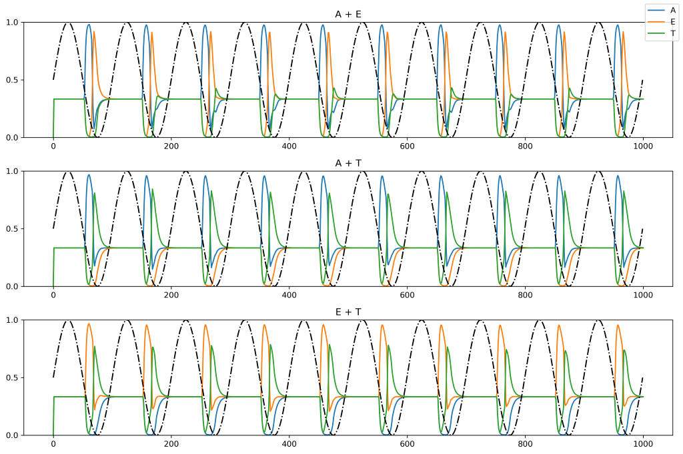
Replication old model

Slide 6
Replication old model

Slide 7
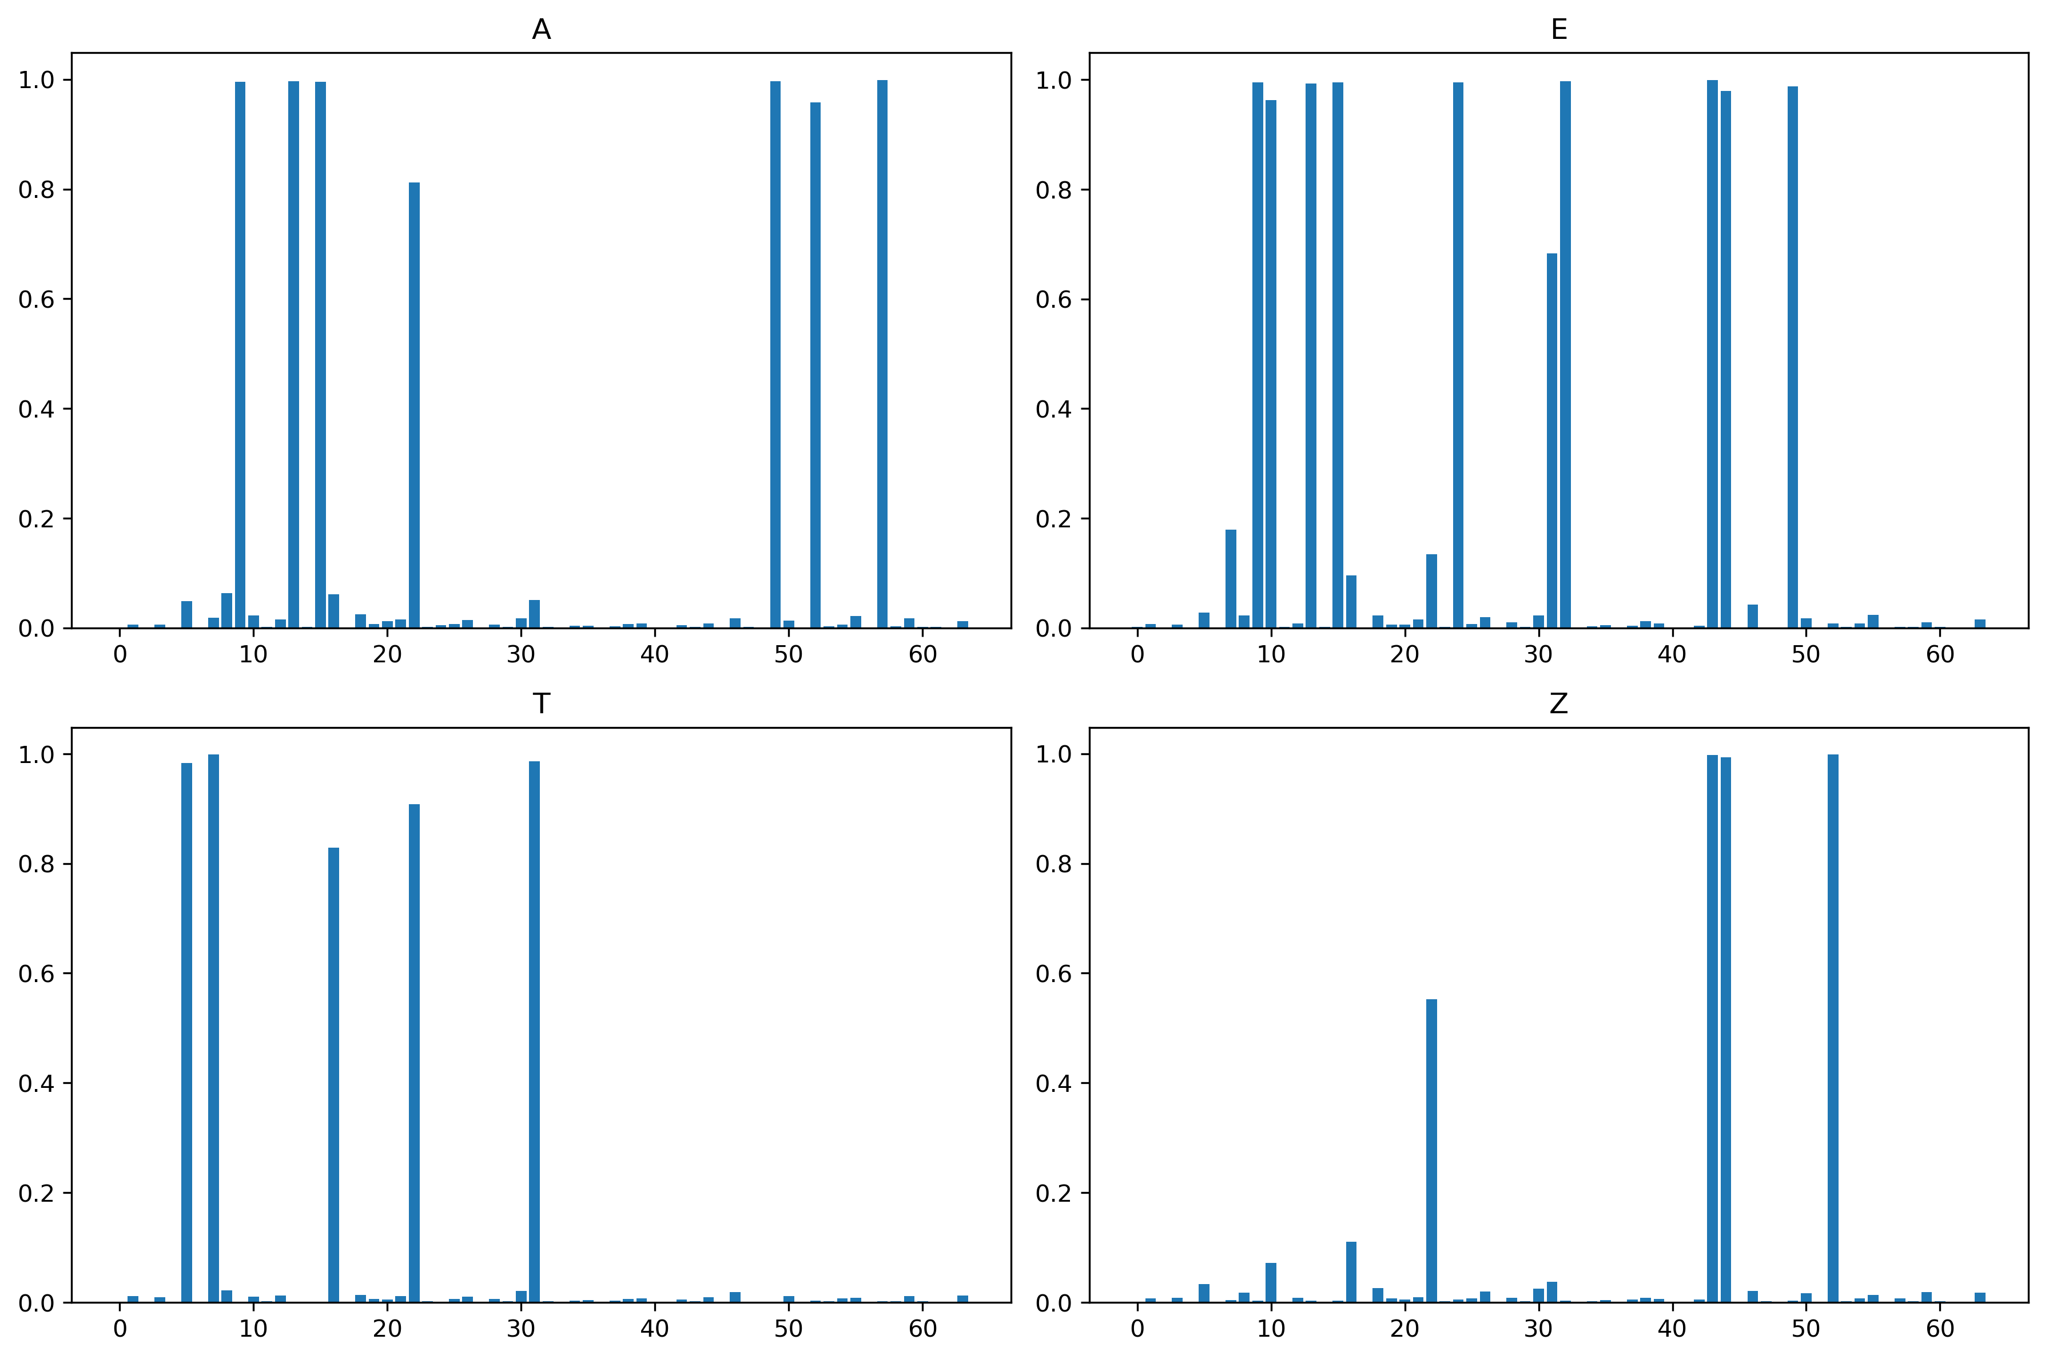
Replication old model with 4 letters
Sparse hidden activations (due to shifted sigmoid)

Slide 8
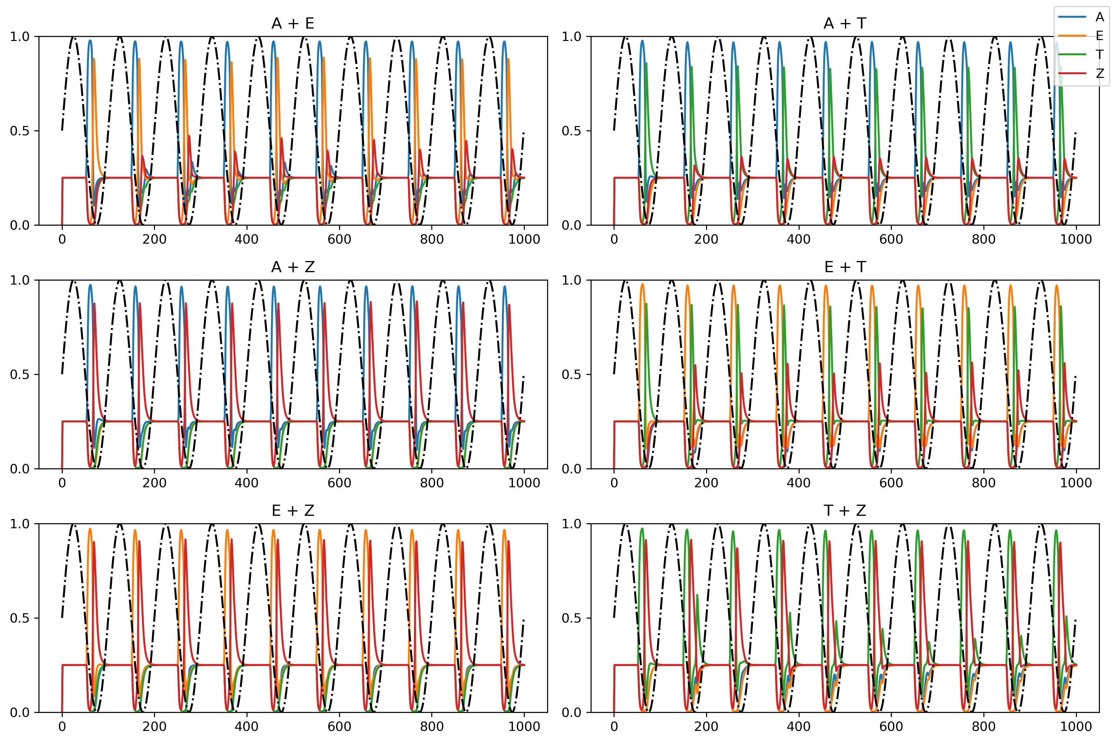
Replication old model with 4 letters

Slide 9
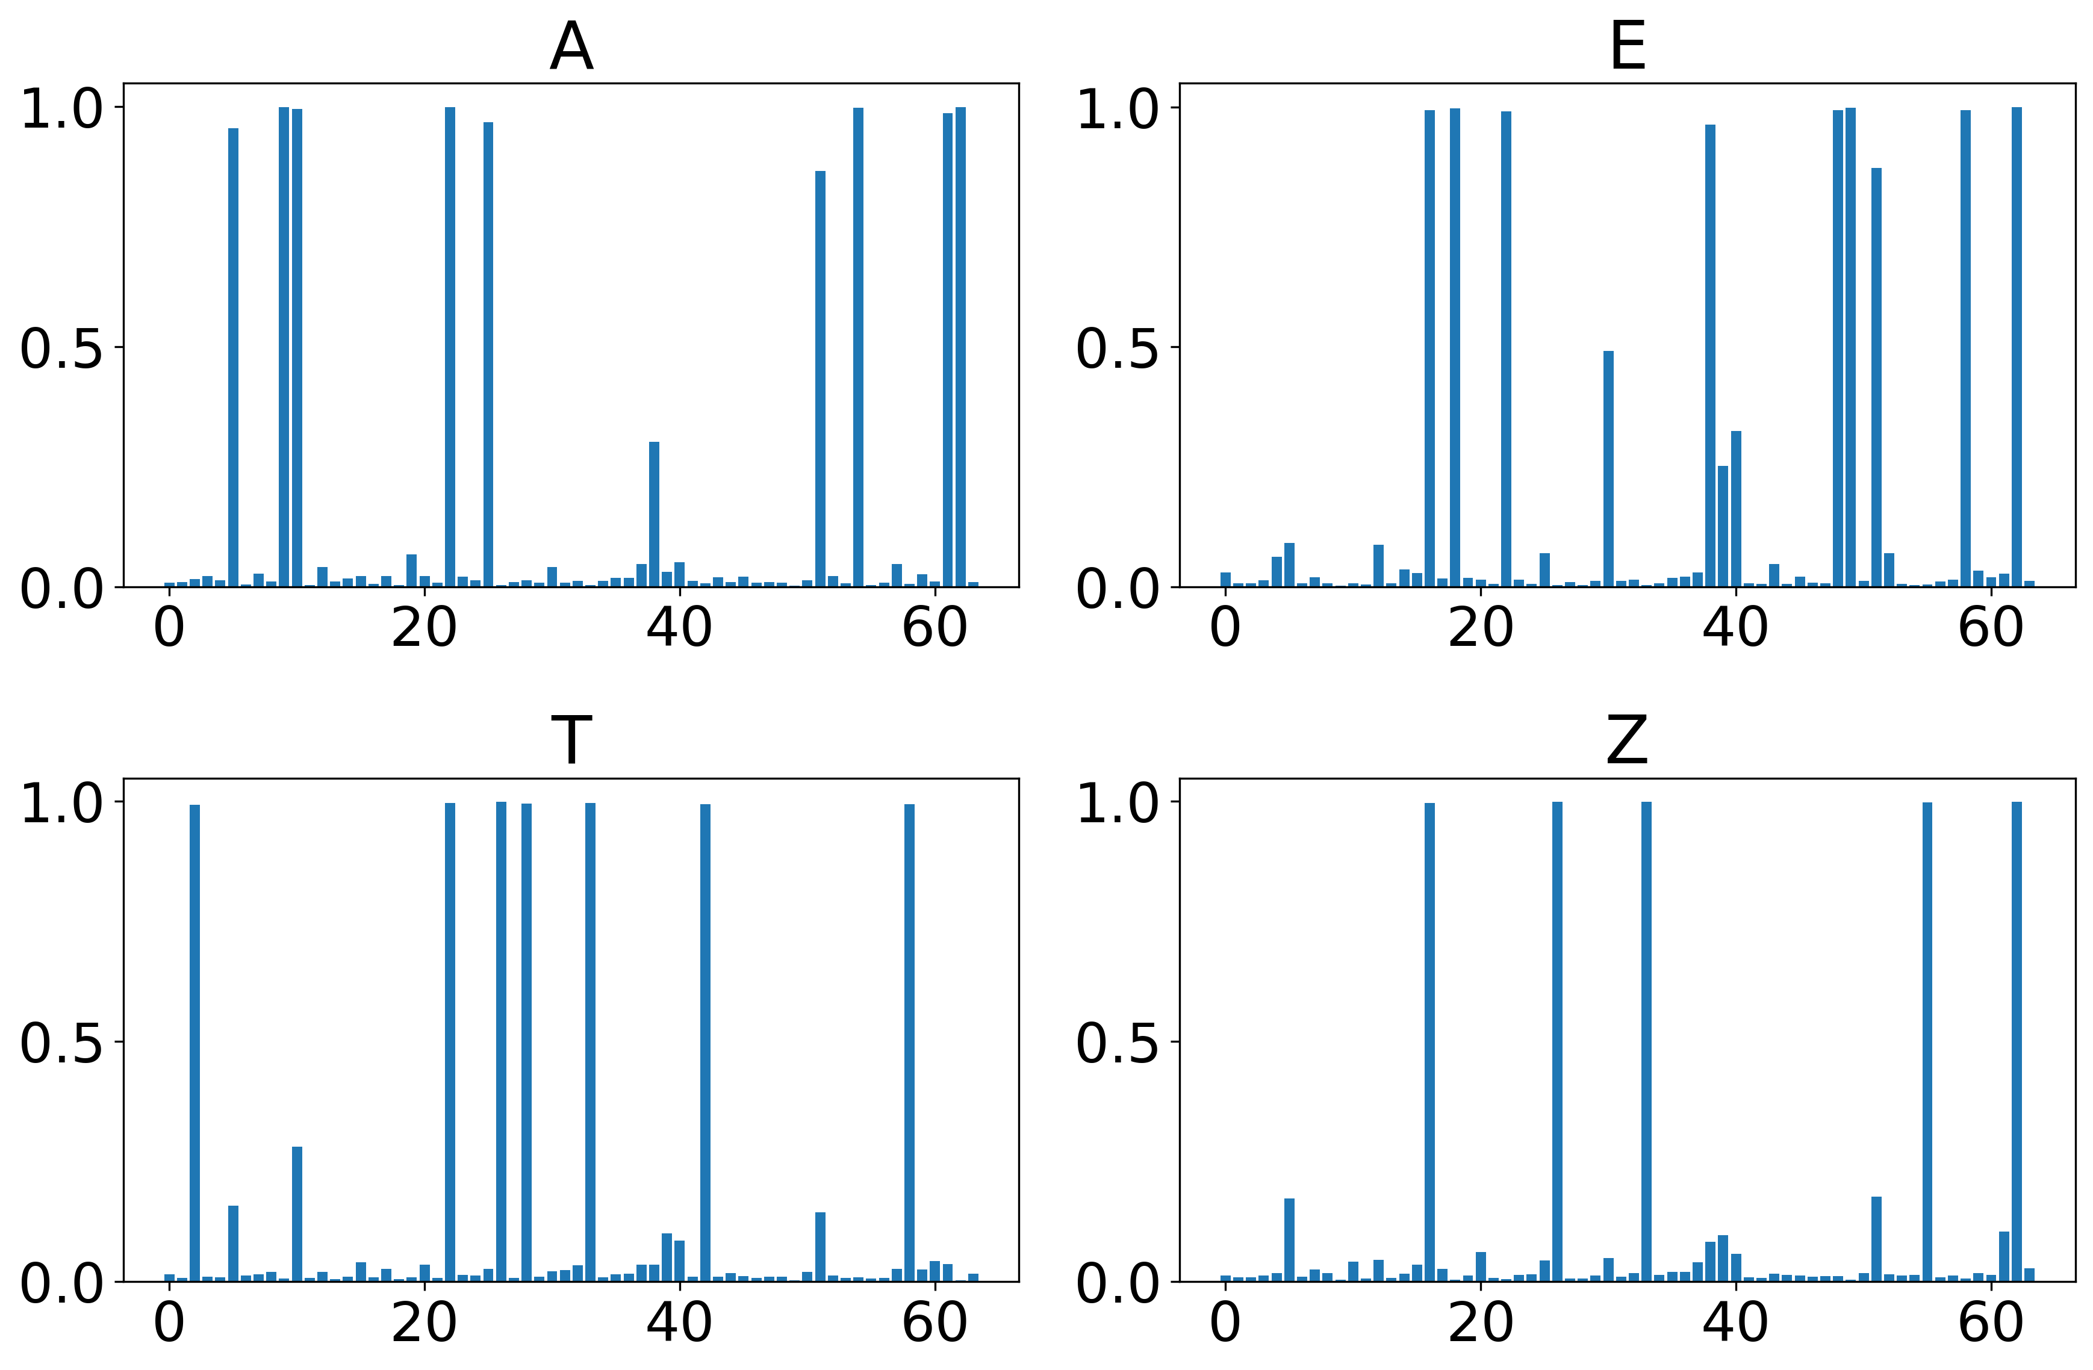
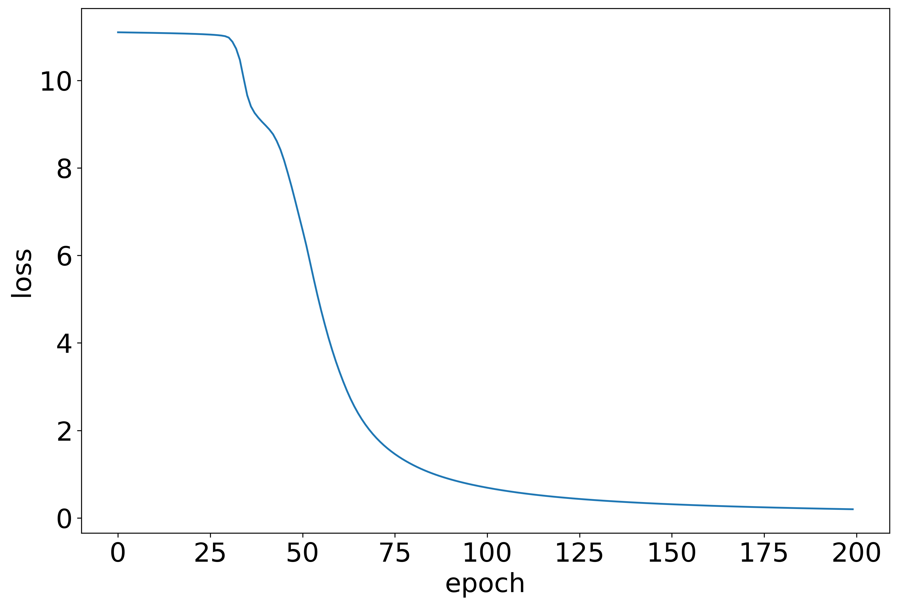
Binary cross-entropy loss & shifted sigmoid

Slide 10
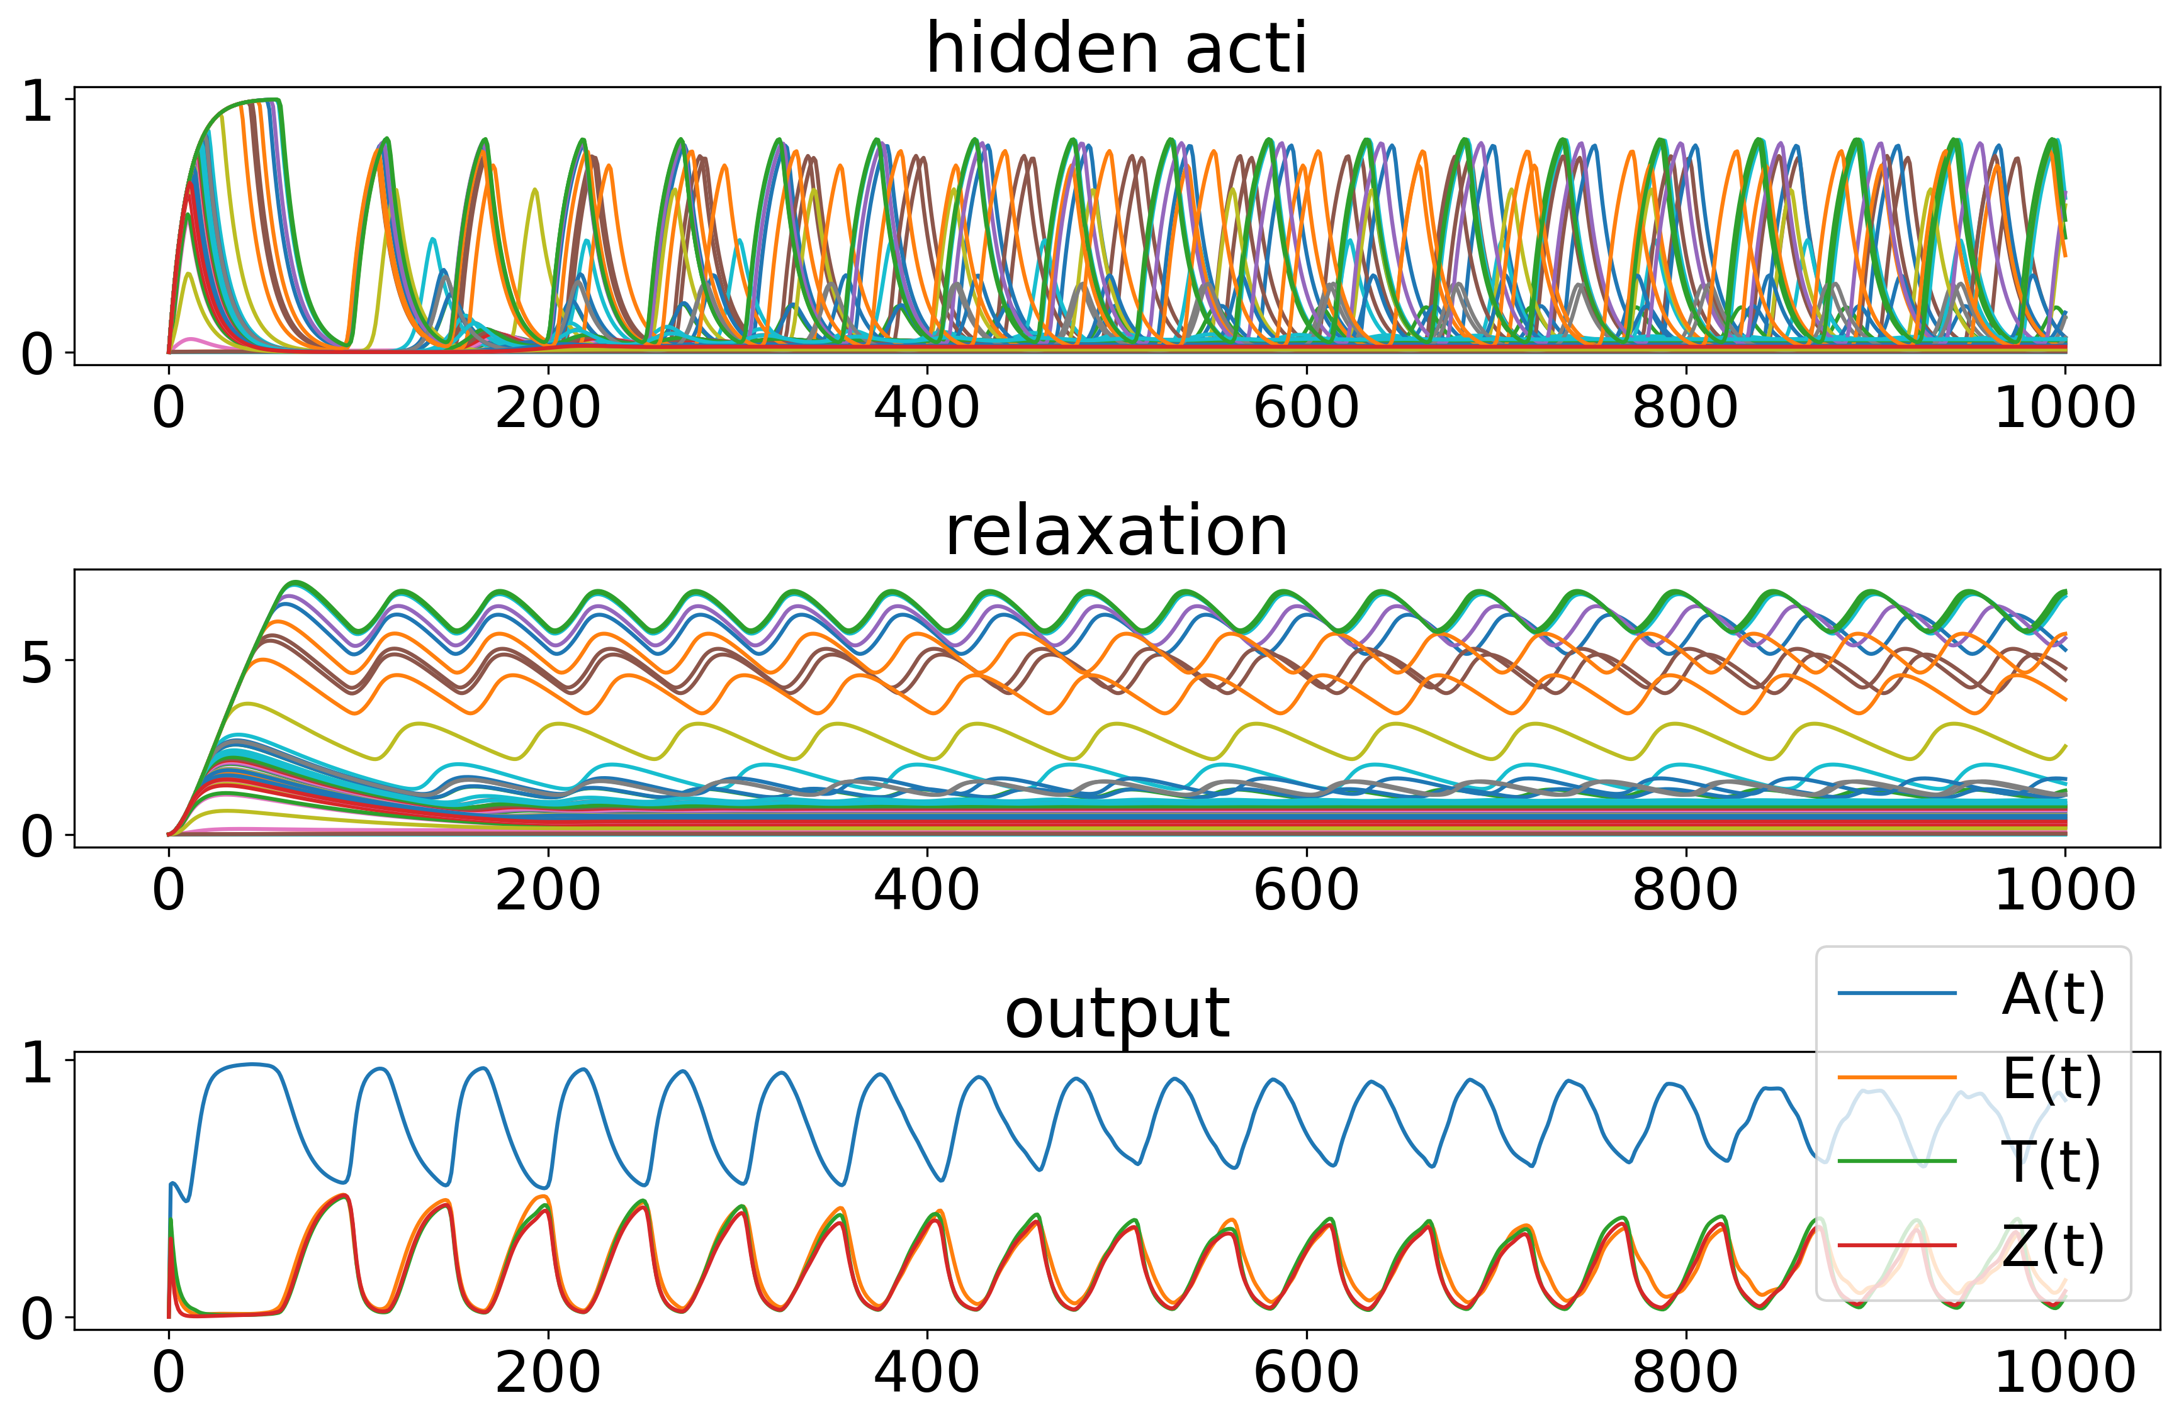
Binary cross-entropy loss & shifted sigmoid

Slide 11
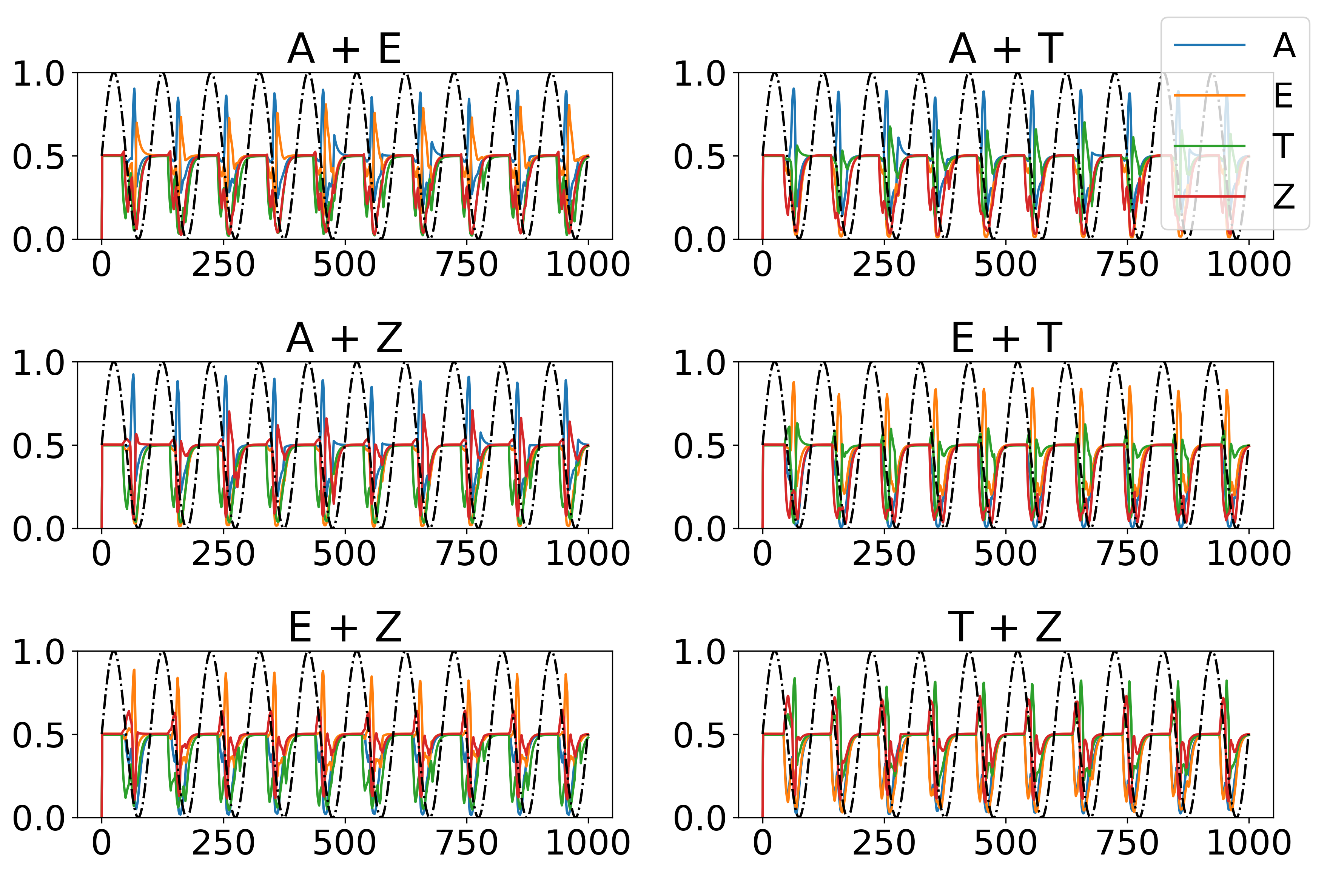
Binary cross-entropy loss & shifted sigmoid

Slide 12
Binary cross-entropy loss & shifted sigmoid

Slide 13
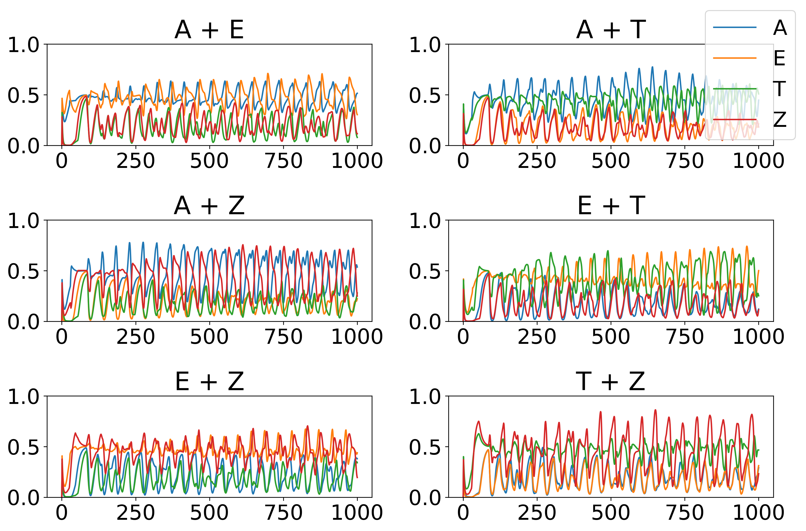
Binary cross-entropy loss & shifted sigmoid

Slide 14
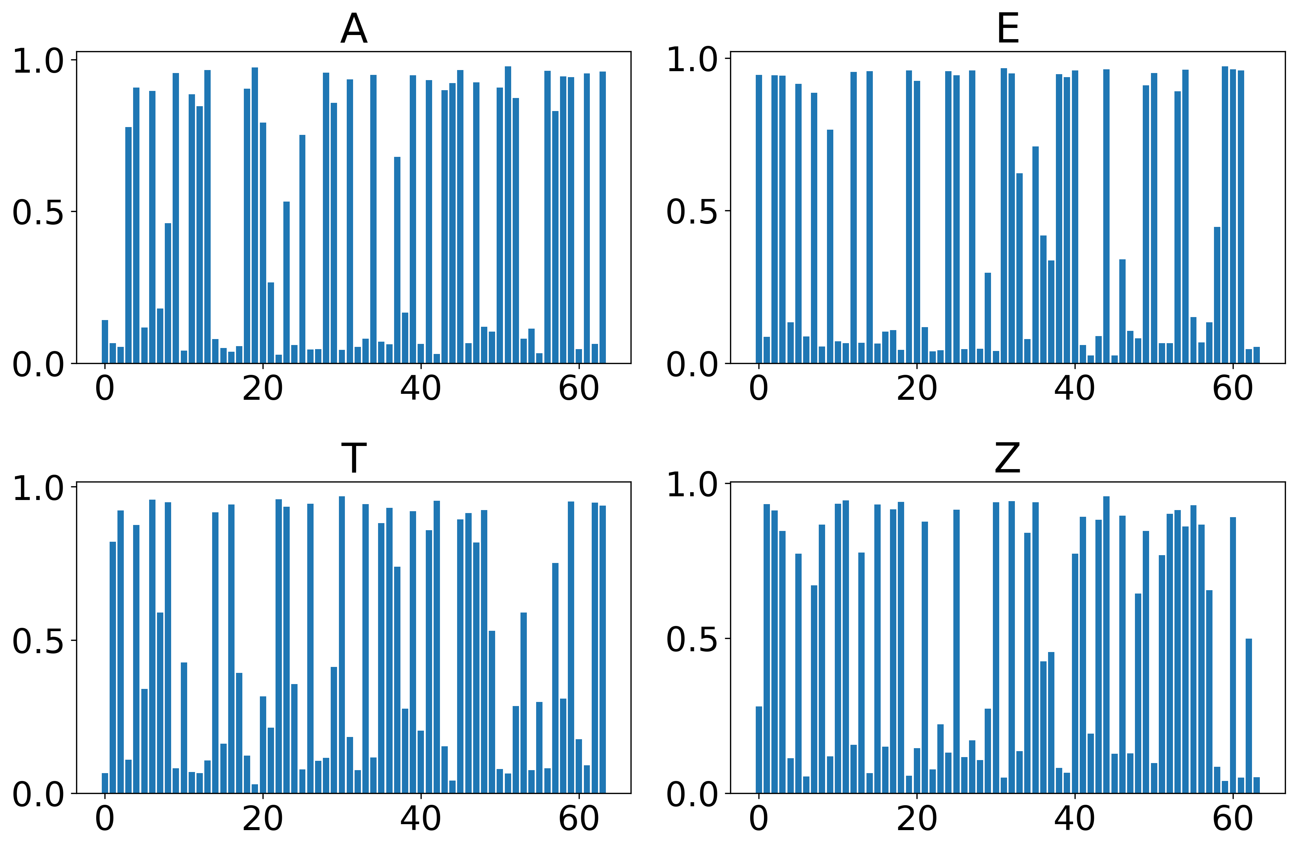
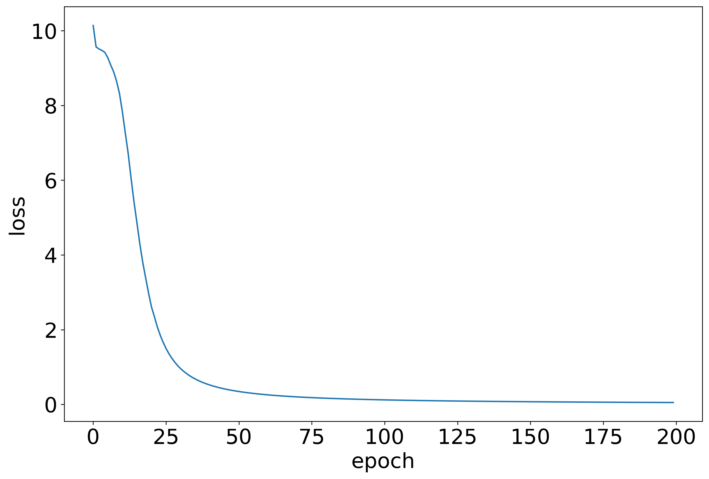
Binary cross-entropy loss & learned bias

Slide 15
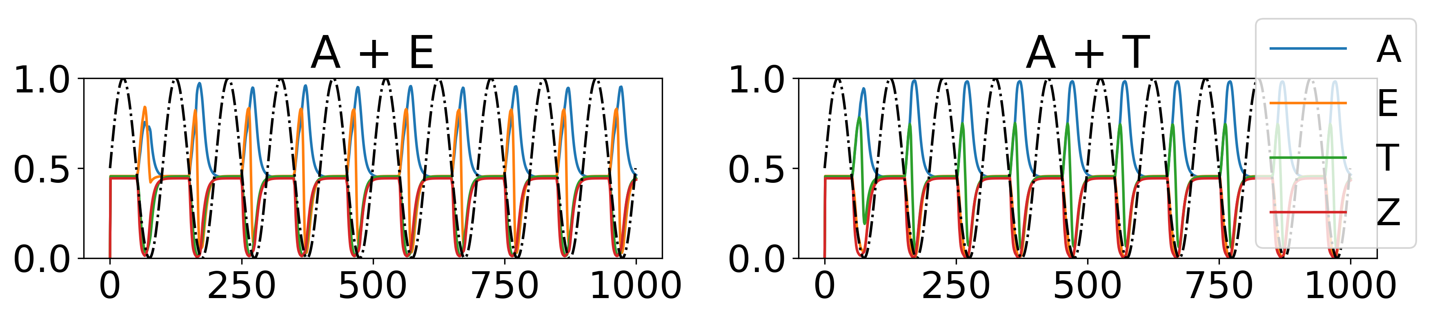
Binary cross-entropy loss & learned bias [similar results with drop out]

Slide 16
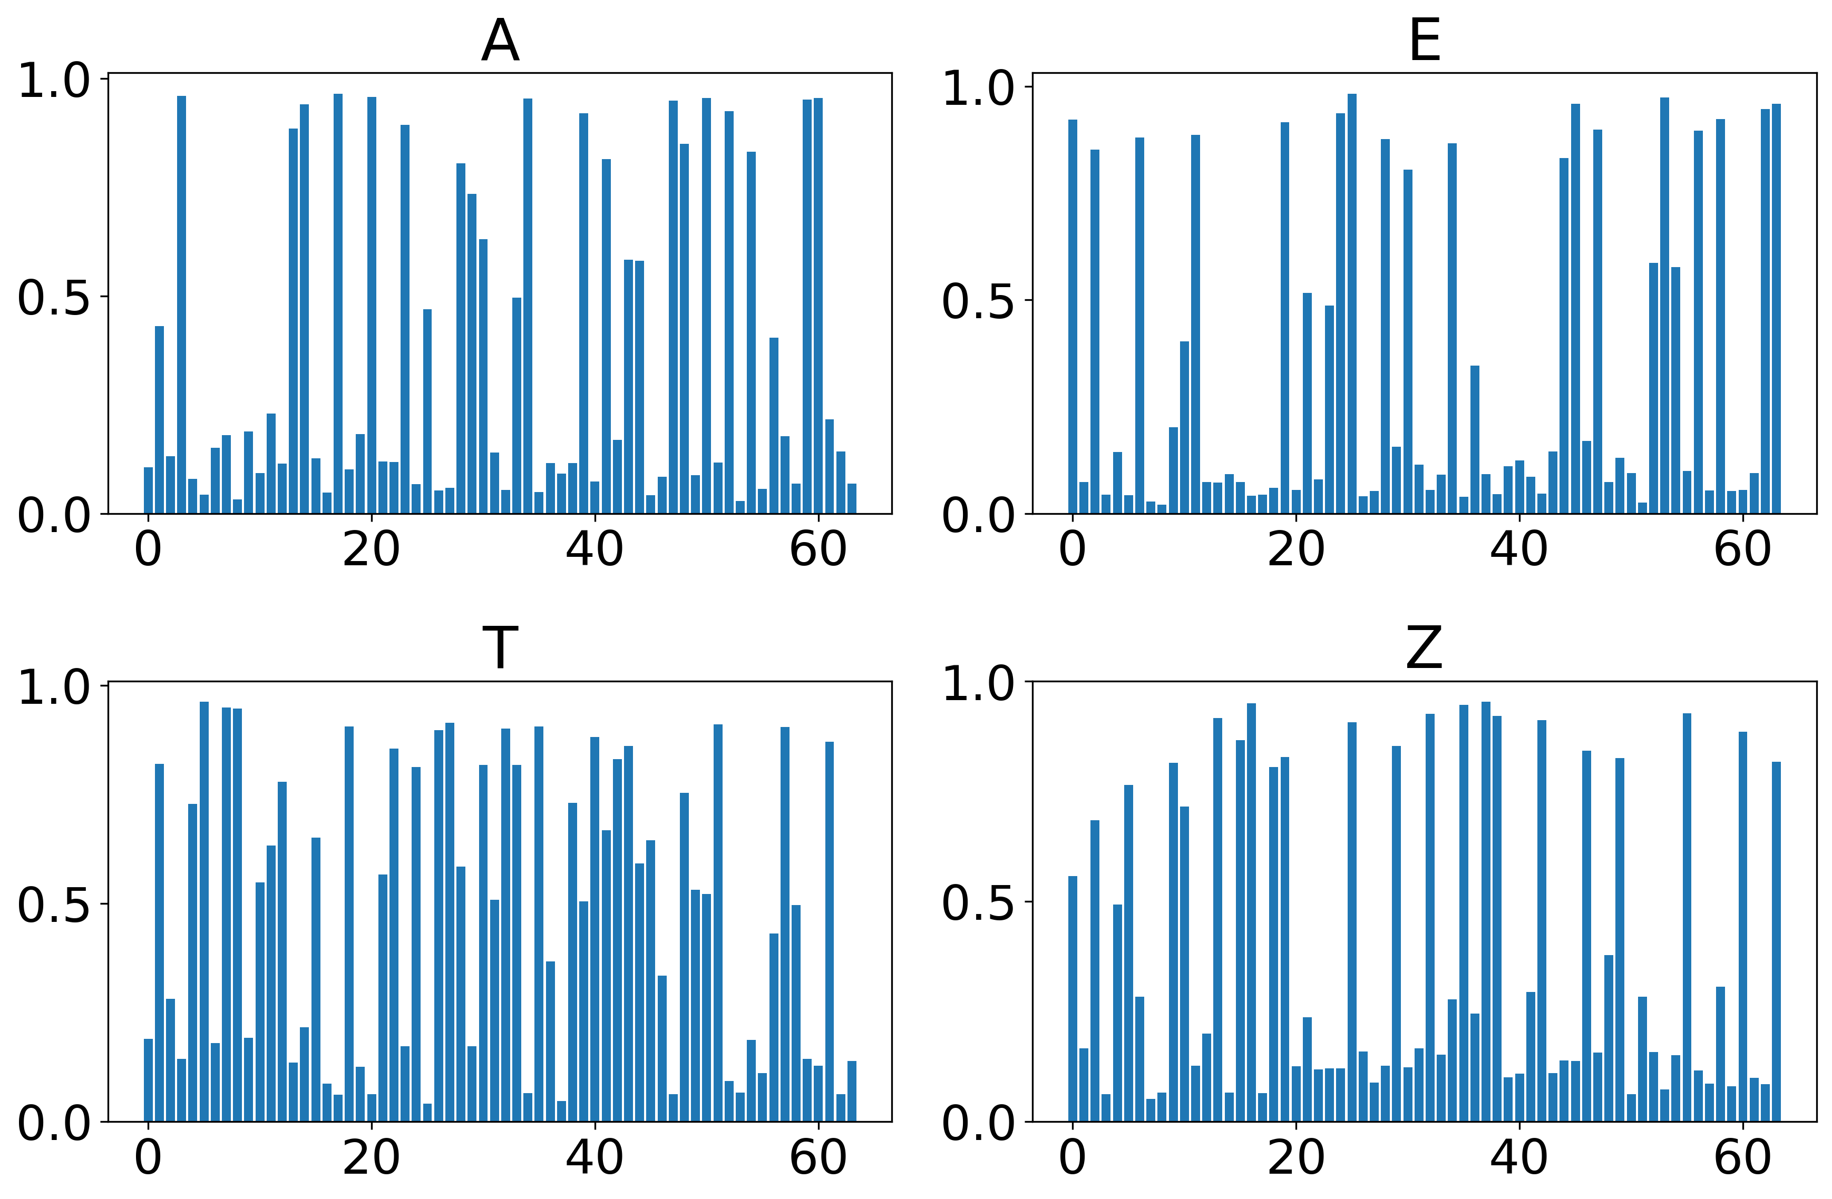
Cross-entropy loss & learned bias

Slide 17
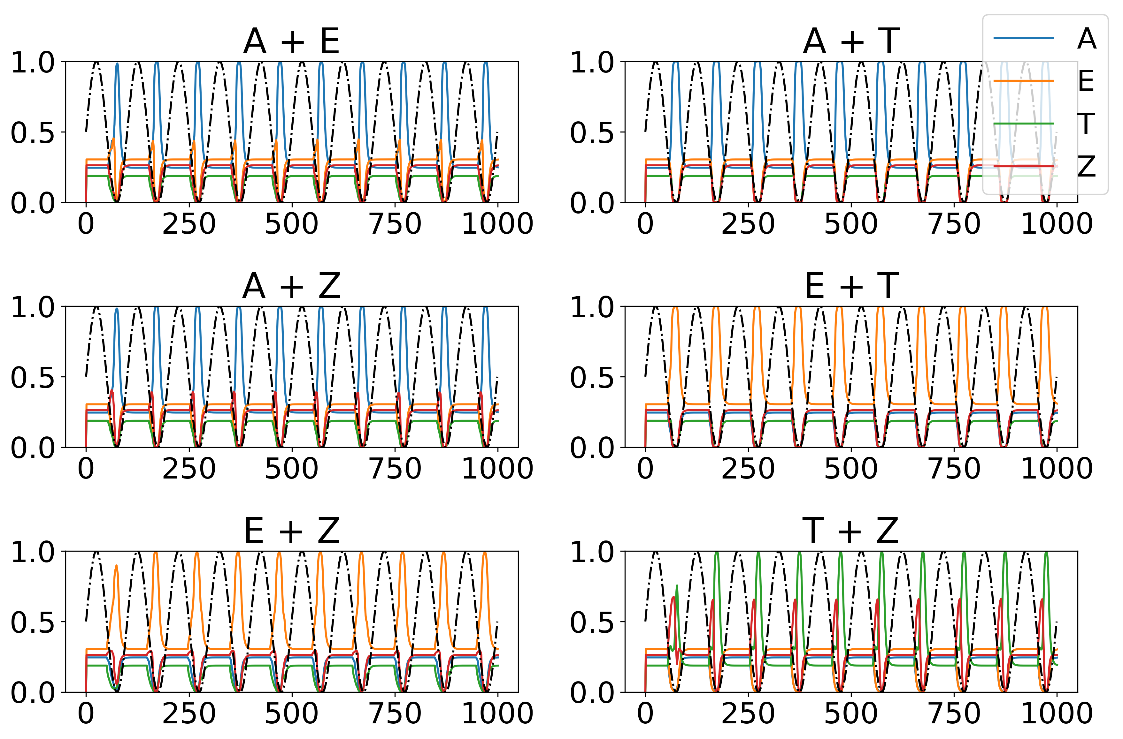
Cross-entropy loss & learned bias

Slide 18
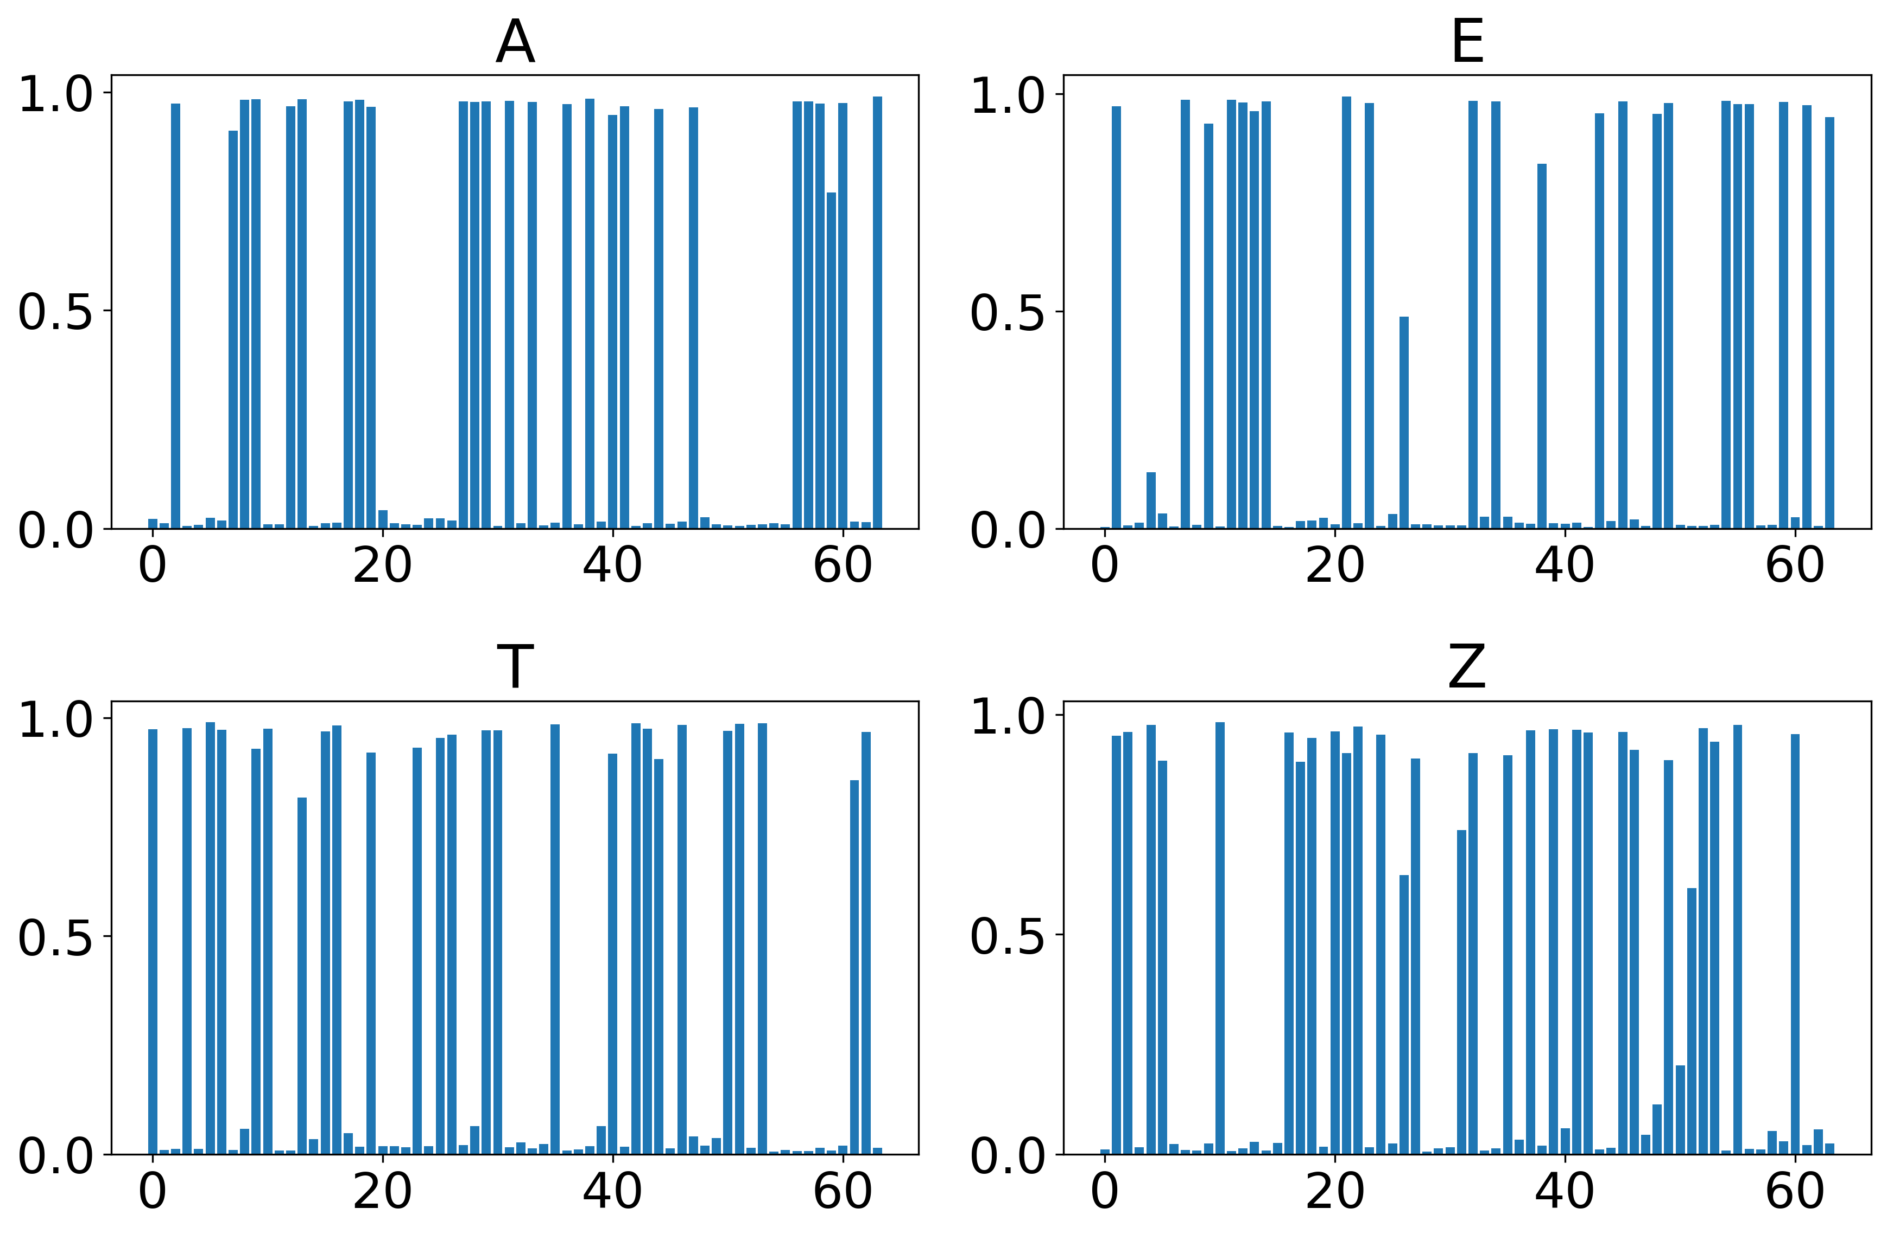
Cross-entropy loss & learned bias & drop out (drop out = 0.3 – keep 30% of hidden nodes for each epoch)

Slide 19
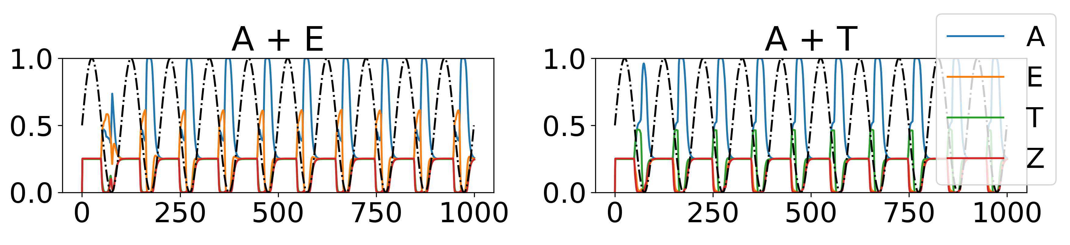
Cross-entropy loss & learned bias & drop out (drop out = 0.3 – keep 30% of hidden nodes for each epoch)

Slide 20
Difficulties
Maximizing distance between hidden representations without using shifted sigmoid & when learning bias
Binary cross-entropy loss: no competition between letters in output layer

Slide 21
Outlook & bigger picture
Oscillations solve bottleneck problems between
Retain information with relatively small layers
Autoencoders and Transformers? (networks with built-in attention)
Recurrencies could be used to incorporate memory into the network (similar to RNN/LSTM, but not for time series data)
For time series: can we overcome vanishing gradient problem?

Slide 22
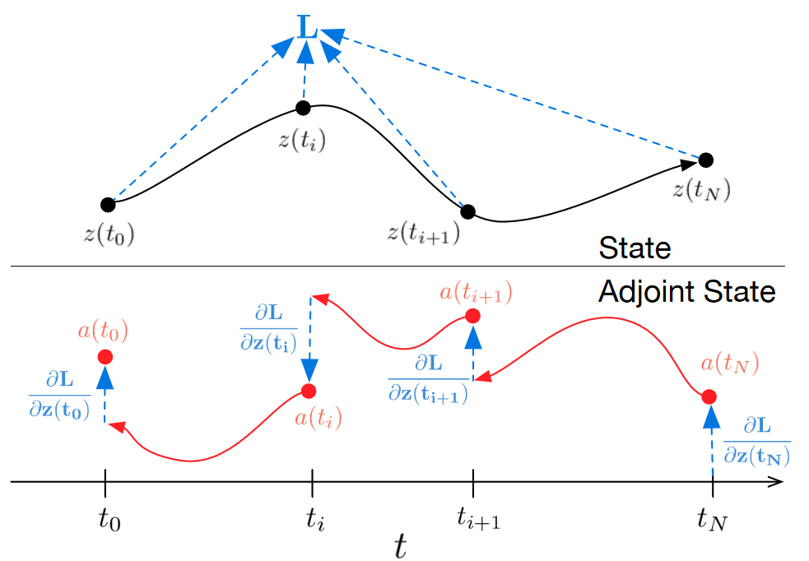
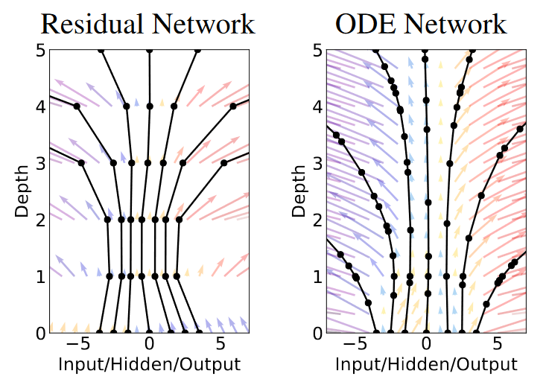
Similar ideas
Neural ODE‘s (Chen et al., 2018, NeurIPS)

Slide 23
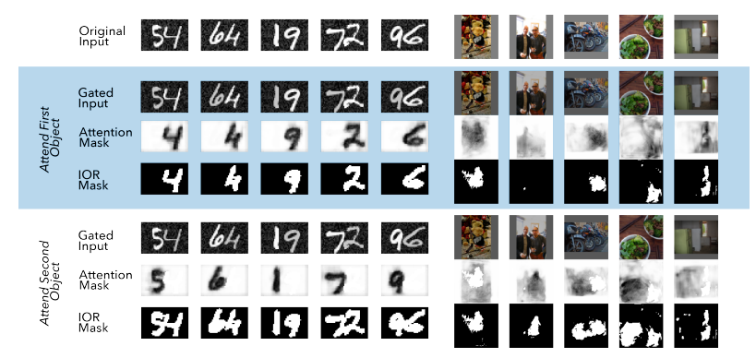
Similar ideas
Object-based attention model (Lei et al., 2021, bioRxiv)

Slide 24
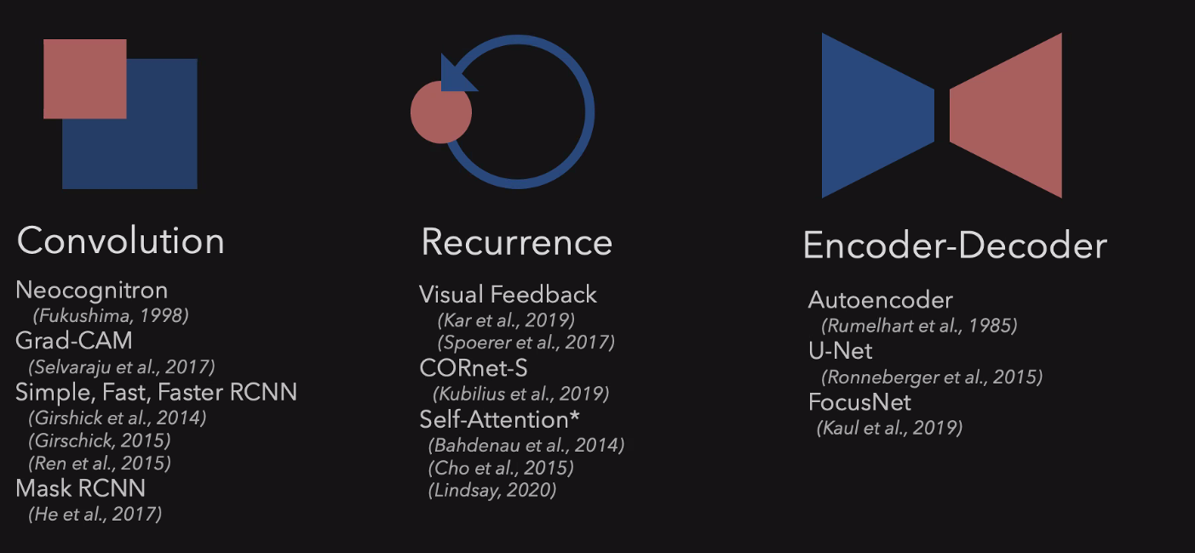
Similar ideas
Object-based attention model (Lei et al., 2021, bioRxiv)

Slide 25
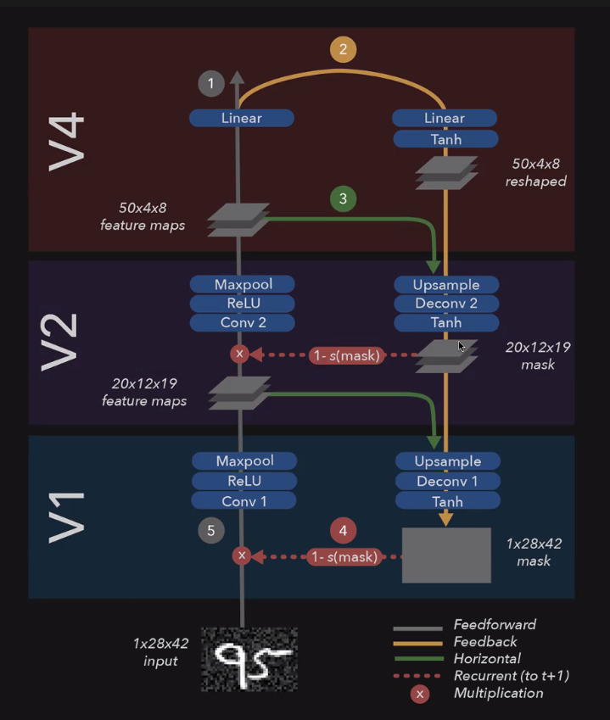
Similar ideas
Object-based attention model (Lei et al., 2021, bioRxiv)

